Slide 1

1st Annual Holiday Lights Contest
Let’s Brighten up the 2020 Holidays!

Slide 2
Thank you West Whiteland Township Board of Supervisors
Let’s Brighten up the 2020 Holidays!

Slide 3
Friends of the Parks 2020 Sponsors
Greater Philadelphia Cultural Alliance
H. A. Thomson Co.
1st Resource Bank
Experience Christian Church
Exton Regional Chamber of Commerce
Hankin Foundation
Traffic, Planning & Design Inc.

Slide 4
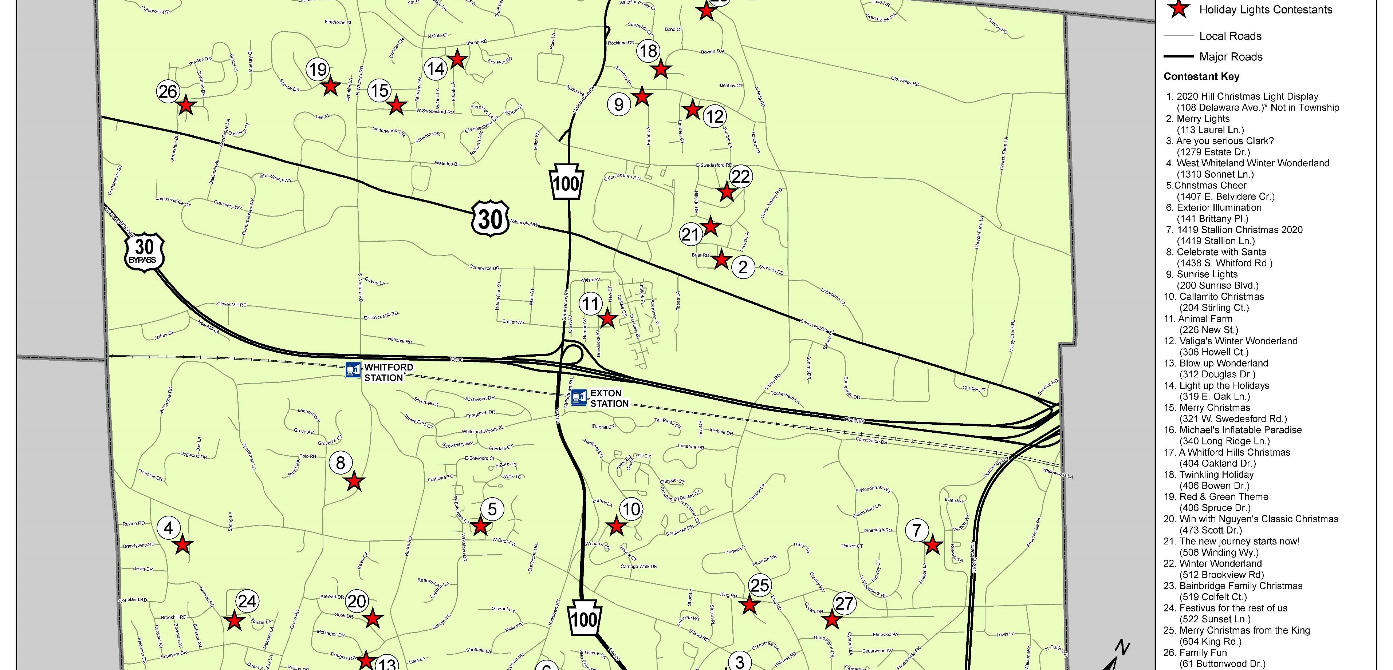
27 entries in all 4 quadrants of the Township!

Slide 5
Winners of the 1st Annual Holiday Lights Contest
Top ….
Business
Townhomes
Single Family Homes
People’s Choice

Slide 6
Top Business Awarded to:
“Sunrise Lights”
By Sunrise of Exton – A Senior Living Facility

Slide 7
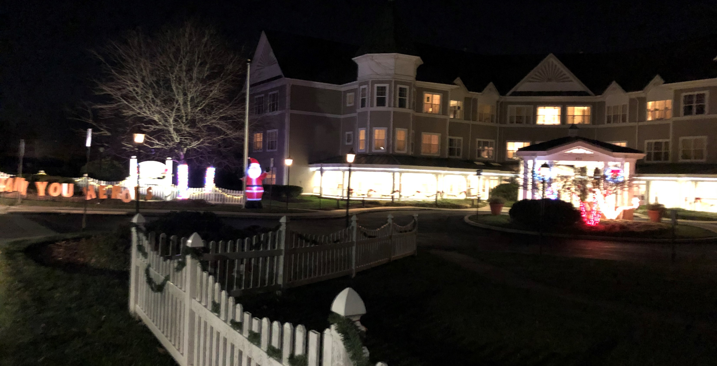

Slide 8
Top Townhomes Awarded to:
#1 Callarrito Christmas
#2 Family Fun
#1 “Callarrito Christmas”
#2 “Family Fun”

Slide 9
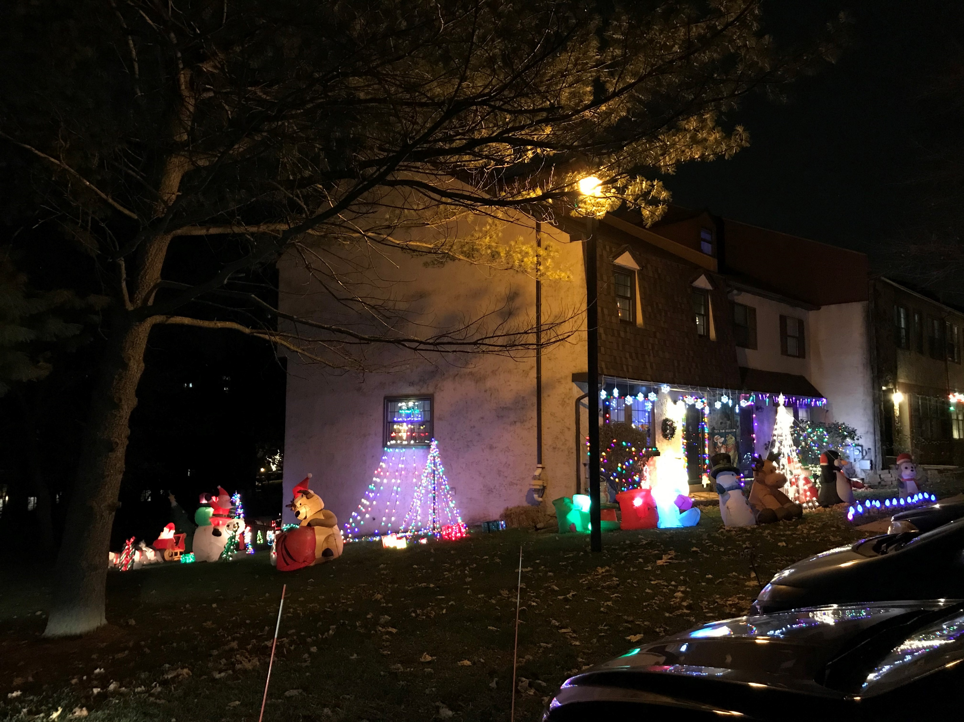
“Callarrito Christmas”

Slide 10
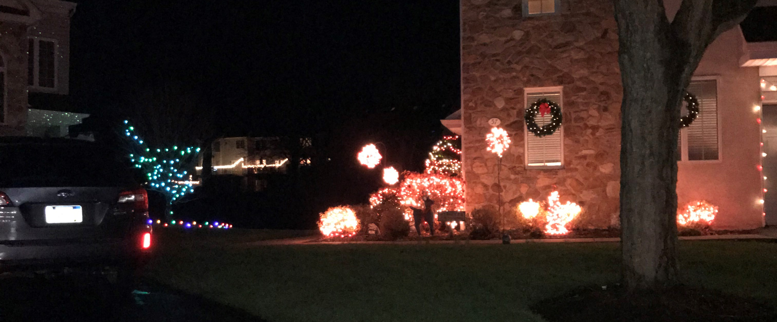
“Family Fun”

Slide 11
Top Single Family Homes Awarded to:
#1 “West Whiteland Winter
Wonderland”
and a Tie for
#2 “Valiga’s Winter Wonderland” & “Merry Christmas from the King”

Slide 12
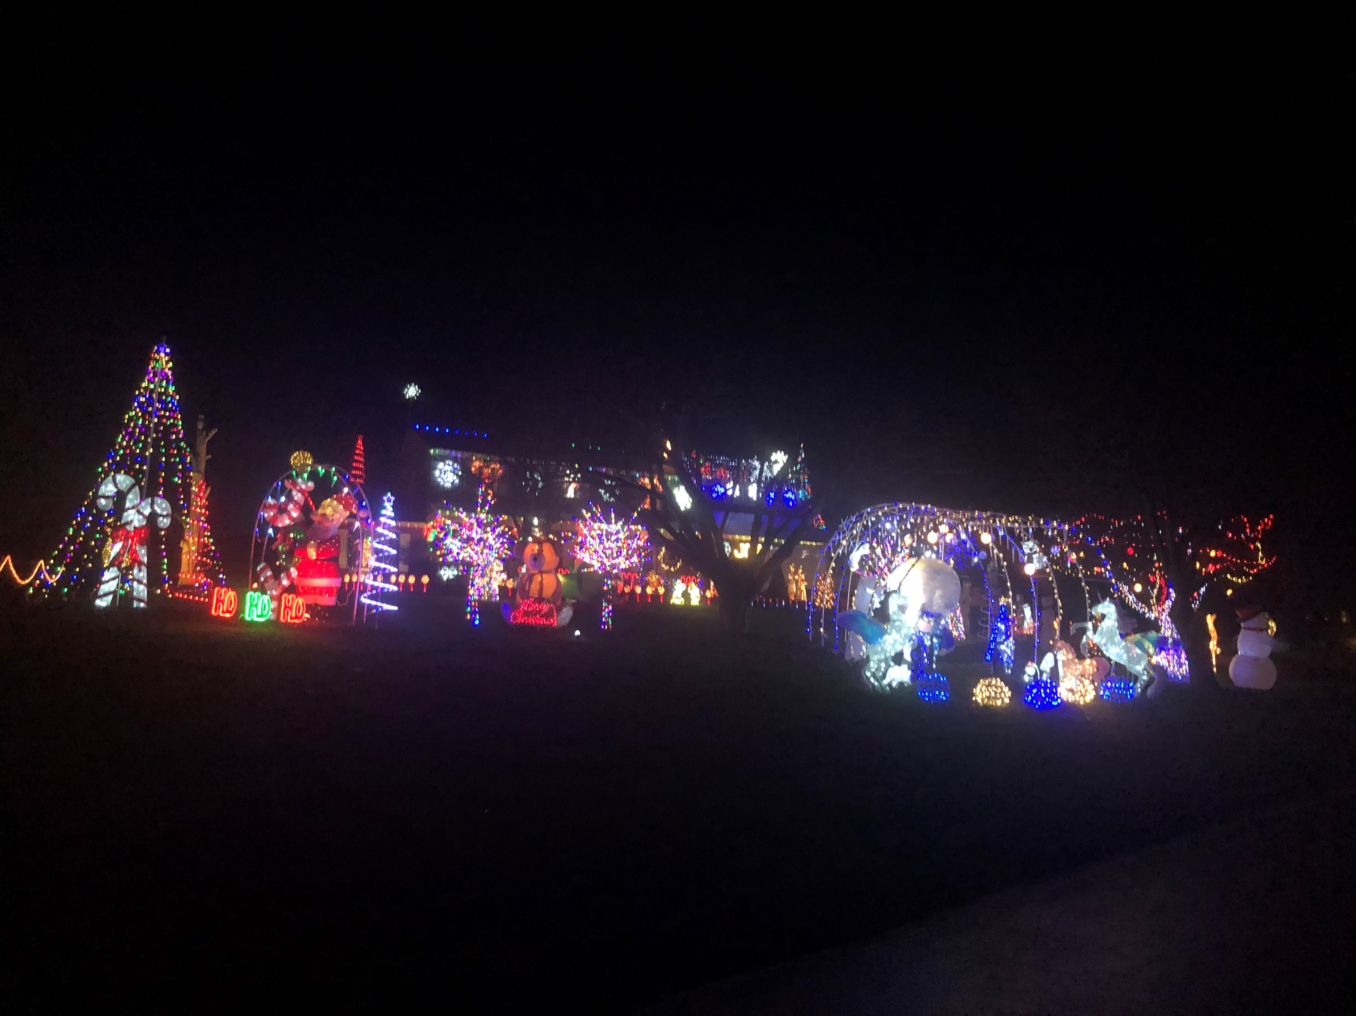
“West Whiteland
Winter Wonderland”

Slide 13
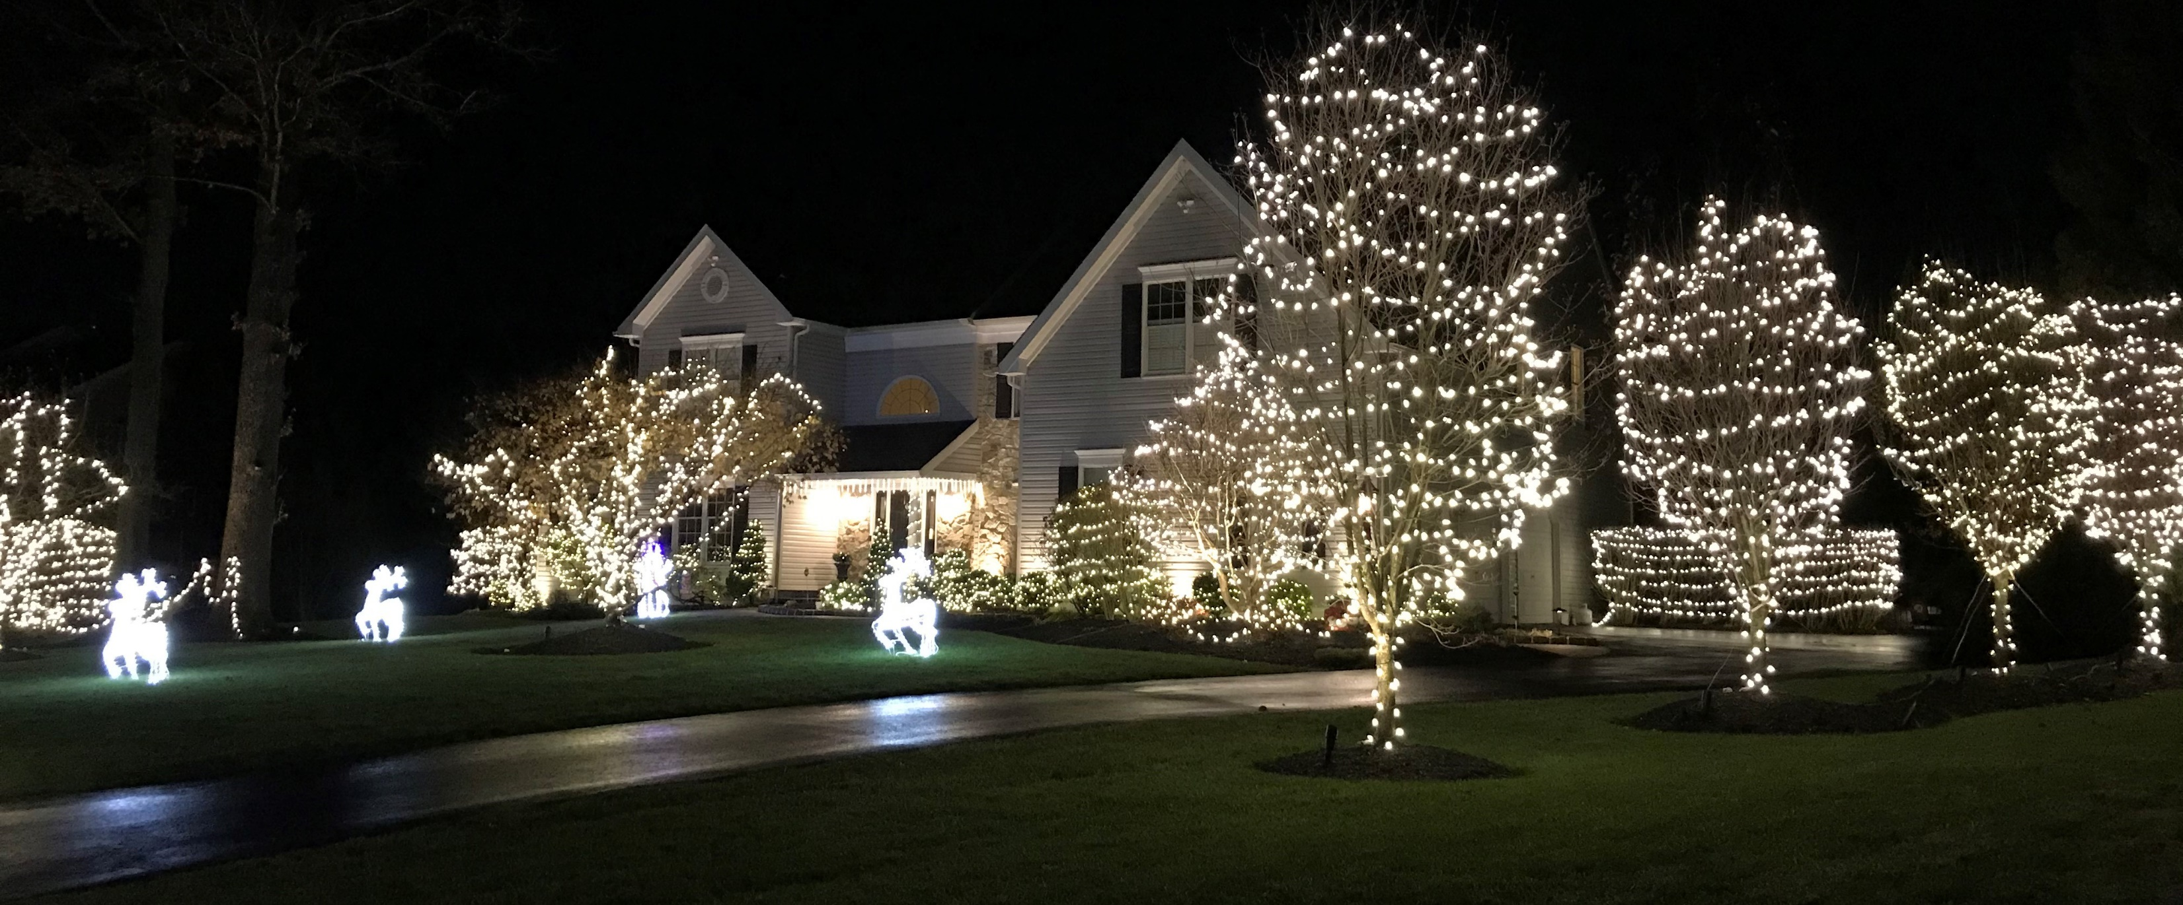
Valiga’s Winter Wonderland

Slide 14
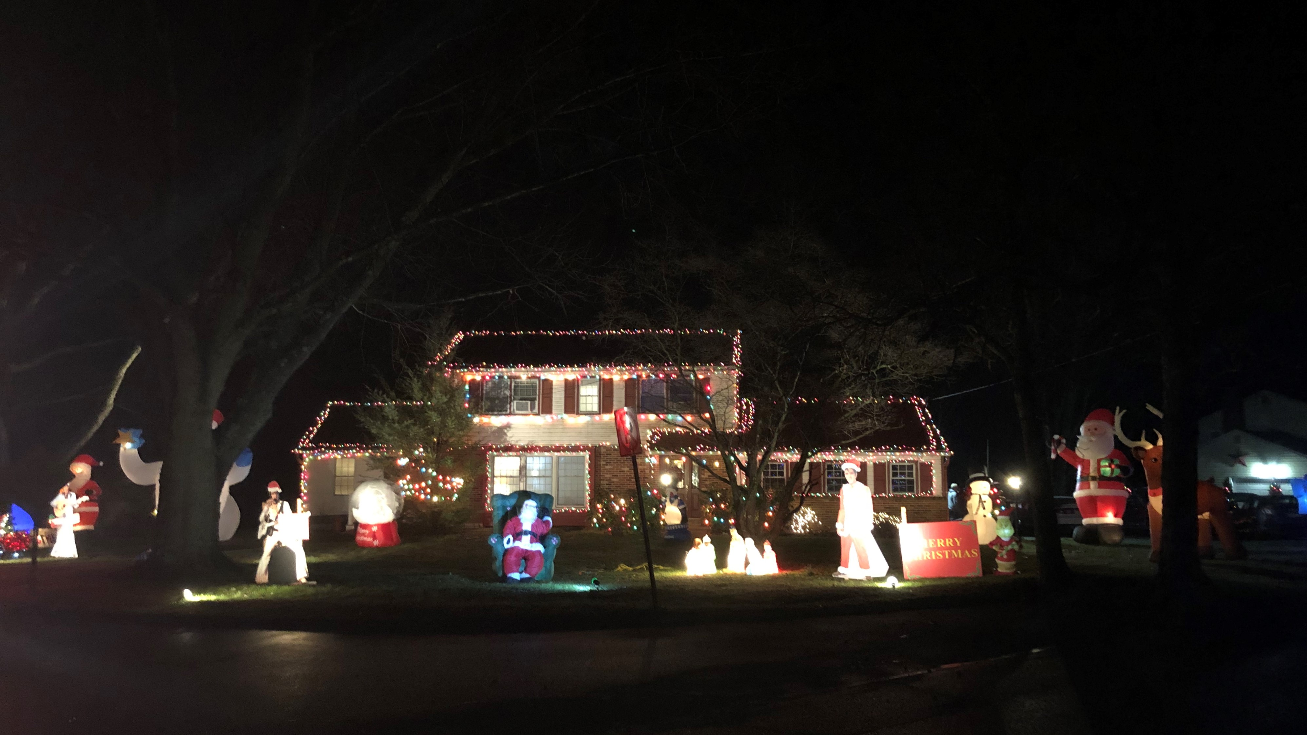
“Merry Christmas from the King”

Slide 15
People’s Choice Award goes to……
#1 “Merry Christmas from the King”
and
#2 “Valiga’s Winter Wonderland”

Slide 16
“Merry Christmas from the King”

Slide 17

Valiga’s Winter Wonderland

Slide 18
Happy Holidays! Join us in 2021 for the 2nd Annual Holiday Lights Contest

